Slide 1

Chapter 9 Evaluating Search Engines
SEG301m

Slide 2
Objectives
How to evaluate search engines?
What are metrices used for evaluation?

Slide 3
Contents
9.1 Why "Evaluate"?
9.2 Evaluation corpus
9.3 Logging
9.4 Effectiveness metrices
9.5 Efficiency metrics
9.6 Training, testing and statistics

Slide 4
9.1 Why "Evaluate"?
Evaluation is the key to making progress in building better search engines
There are two key points to evaluate a search engine
Effectiveness : measures the ability of the search engine to find the right information
Efficiency : measures how quickly this is done
Information retrieval research focuses on improving the effectiveness of search → established as being potentially useful : shifs to finding efficient implementations

Slide 5
9.1 Why "Evaluate"?
Is there a trade-off between efficiency and effectiveness?
In addition to efficiency and effectiveness, the other signifcant consideration in search engine design is cost:
Processors, memory, disk space, and networking

Slide 6
9.2 Evaluation corpus
A text corpus is a large amount of text, usually in the form of many documents, that is used for statistical analysis of various kinds
Evaluation corpus, in information retrieval is unique in that the queries and relevance judgments for a particular search task are gathered in addition to the documents
CACM: Titles and abstracts from the Communications of the ACM from 1958–1979. Queries and relevance judgments generated by computer scientists.
AP: Associated Press newswire documents from 1988–1990 (from TREC disks 1–3). Queries are the title felds from TREC topics 51–150. Topics and relevance judgments generated by government information analysts.
GOV2: Web pages crawled from websites in the .gov domain during early 2004. Queries are the title felds from TREC topics 701–850. Topics and relevance judgments generated by government analysts.

Slide 7
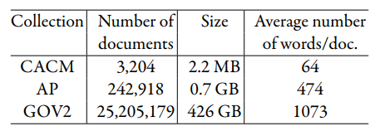
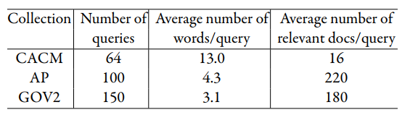
9.2 Evaluation corpus
Statistics for three example text collections. Te average number of words per document is calculated without stemming.
Statistics for queries from example text collections

Slide 8
9.3 Logging
Query logs that capture user interactions with a search engine have become an extremely important resource for web search engine development
Query log data can potentially support a much more extensive and realistic evaluation.
Drawbacks
It is not as precise as explicit relevance judgments
An additional concern is maintaining the privacy of the users

Slide 9
9.3 Logging
A typical query log will contain
User identifer or user session identifer
Query terms
List of URLs of results
Timestamp

Slide 10
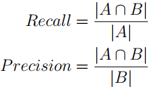
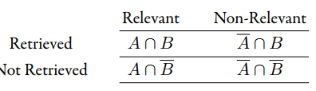
9.4 Effectiveness metrices: Recall and Precision
Sets of documents defned by a simple search with binary relevance

Slide 11


9.4 Effectiveness metrices: Recall and Precision
The proportion of non-relevant documents that are retrieved
F measure

Slide 12

9.4 Effectiveness metrices: Averaging and Interpolation
Mean average precision (MAP)
where n is the number of queries, and APi is the average precision for query i

Slide 13
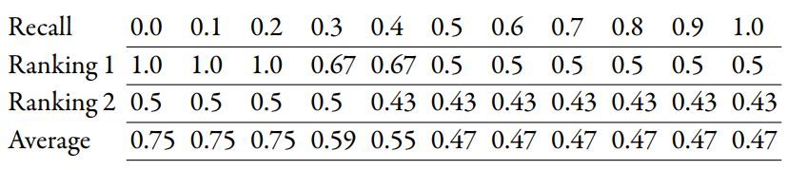
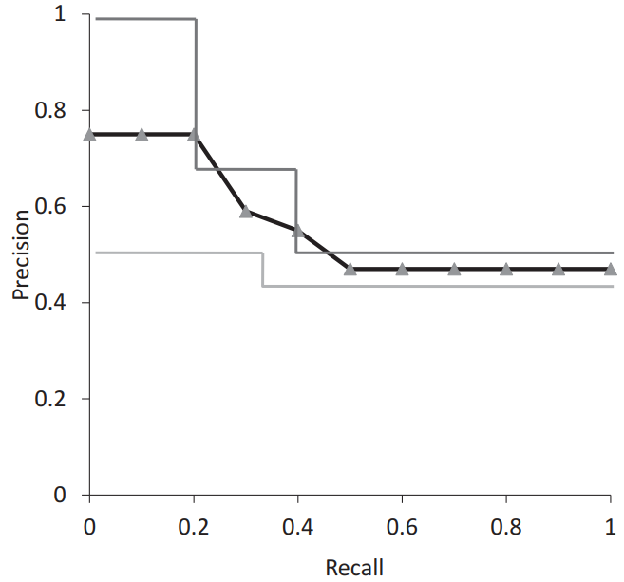
9.4 Effectiveness metrices: Averaging and Interpolation
Precision values at standard recall levels calculated using interpolation
Average recall-precision graph
using standard recall levels

Slide 14


9.4 Effectiveness metrices: Focusing on the Top Documents
Navigational search and navigational search have single relevant document → recall is not an appropriate measure → an effectiveness measure more suitable
Measure with this property: precision at rank p, where p in this case will typically be 10
Many measures proposed:
Reciprocal rank
Discounted cumulative gain(DCG)
where reli is the graded relevance level of the document retrieved at rank i

Slide 15

9.4 Effectiveness metrices: Focusing on the Top Documents
Normalized discounted cumulative gain (NDCG)
where IDCG is the ideal DCG value for that query

Slide 16

9.4 Effectiveness metrices: Using Preferences
Two rankings described using preferences can be compared using the Kendall tau coefficient (τ)
where P is the number of preferences that agree and Q is the number that disagree
Notes:
Tis measure varies between 1 (when all preferences agree) and –1 (when they all disagree)

Slide 17
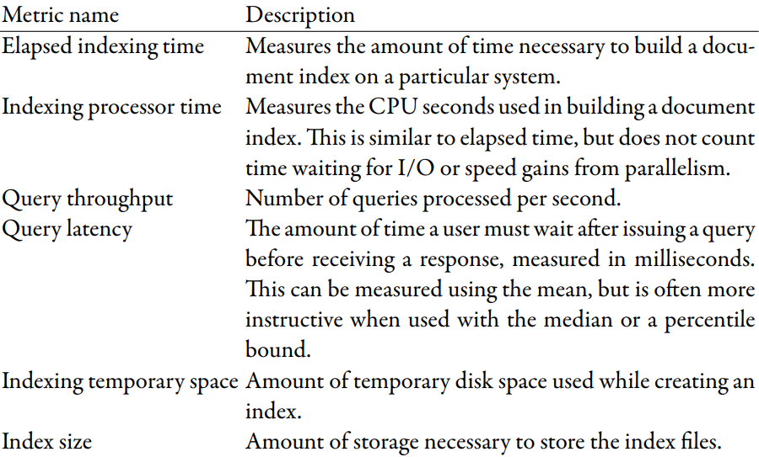
9.5 Efficiency metrics

Slide 18
9.6 Training, testing and statistics: Significance Tests
Every signifcance test is based on a null hypothesis
The null hypothesis is that there is no difference in effectiveness between the two retrieval algorithms
The alternative hypothesis is that there is a difference
Given two retrieval algorithms A and B, where A is a baseline algorithm and B is a new algorithm, we are usually trying to show that the effectiveness of B is better than A

Slide 19
9.6 Training, testing and statistics: Significance Tests
The procedure for comparing two retrieval algorithms
1. Compute the effectiveness measure for every query for both rankings.
2. Compute a test statistic based on a comparison of the effectiveness measures for each query.
3. The test statistic is used to compute a P-value, which is the probability that a test statistic value at least that extreme could be observed if the null hypothesis were true.
4. The null hypothesis(no difference) isrejected in favor ofthe alternate hypothesis (i.e., B is more effective than A) if the P-value is≤ α, the signifcance level.
Notes:
The test statistic depends on the signifcance test, and is simply a quantity calculated from the sample data that is used to decide whether or not the null hypothesis should be rejected
Small P-values suggest that the null hypothesis may be false.
Values for α are small, typically 0.05 and 0.1, to reduce the chance of a Type I error

Slide 20
9.6 Training, testing and statistics: Setting Parameter Values
Nearly every ranking algorithm has parameters that can be tuned to improve the effectiveness of the results.
The appropriate method of setting parameters for both maximizing effectiveness and making fair comparisons of algorithms is to use a training set and a test set of data

Slide 21
9.6 Training, testing and statistics: Online Testing
For real search engines, it may be possible to test (or even train) using live traffic. → online testing
Benefits:
Allows real users to interact with the system
Less biased since the evaluation is being done over a real sample of users and traffic
Drawbacks:
The data collected is typically very noisy
Requires live traffic to be altered in potentially harmful ways
Useful, inexpensive way of training or testing new algorithms, especially those that can be evaluated using click data
Notes:
Example: developed a new sponsored-search advertising algorithm
deploy the new ranking algorithm and observe the amount of revenue generated using the new algorithm versus some baseline algorithm → using live traffic and real users.

Slide 22
Exercise
Run the following ambiguous and under-specified queries on a commercial Web search engine: (a) “jaguar”, (b) “windows”, (c) “hello”, and (d) “charles clarke”. How many different interpretations appear in the top ten results?

Slide 23
Summary
Evaluation corpus
Logging
Effectiveness metrices: recall and precision, average and terpolation, focusing on the top documents, using preferences
Efficiency metrics
Training, testing and statistics: significance tests, setting parameter values, Online testing

